Slide 1

CodeU Class 1 Welcome!
The class will start shortly
Reproduction and distribution of the presentation deck is prohibited

Slide 2
Agenda for today’s class
Introduction
01
02
Recap of Trial Class
Let’s get to know each other!
To refresh our minds!
Topic of the day:
03
04
Practice time!
Learn to use the app like a pro!
Print, variables and inputs
Wrap-up
Conclusion
05
06
CodeU Robot
Summary of what we’ve learned today
homework and questions

Slide 3
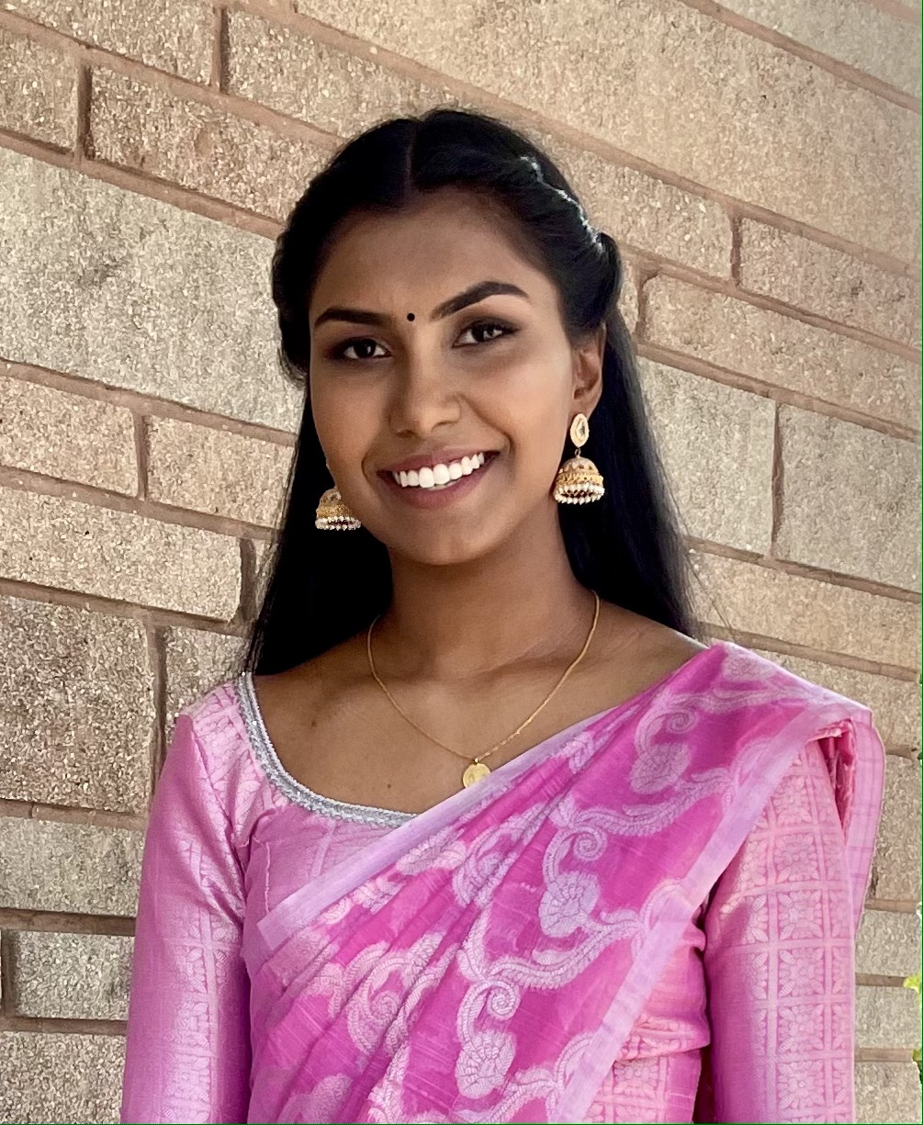

Introduction
01
02
Hi! My name is Sivagamy
How about you?
I will be your tutor for today’s lesson!
What is your name, in what city do you live and how old are you?

Slide 4
Recap of Trial Class
Turtle module
04
Computer programming
Was anyone able to draw the Olympic rings?
Creating a set of instructions that tell a computer how to perform a task.
Printing
03
How do you write code to print?
Programming languages
02
Low level and high level languages. What type is python?
Programming is everywhere!
01
Do you remember any examples of things that use programming? Jobs?

Slide 5





Fun Facts!
Web developer
Did you know?
Writing code to design websites
You need to know programming to be an astronaut!
Video game developer
Creating and editing video games
But that is not the only career opportunity you get with programming!
Cybercrime investigator
Investigate cybercrimes and track hacks

Slide 6
What are Programming Languages?
Definition
Application in the world
Language used to write instructions for the computer.
There are many languages used for every type of task
Zoo keepers
Video games
iPads
Traffic lights
Each language has different rules, syntax and structures, just like French and English
Ex: Binary code
100011001
110000011
100010000
2 types:
Low-level languages
Easy for the computer to read, but very hard for humans.
High-level languages
Use English and mathematical symbols to communicate instructions.
Ex: Python
print (“Hello World”)

Slide 7
Your first code!
01
Type in the following:
Comments
Print(“Hello World!”)
02
Comments are used to annotate your code and to write down notes that you want the interpreter to ignore
Run the program
Run the program in Visual Studio code
03
Start comments using #
What do you see displayed?
Ex: # this comment will be
ignored
Note that the quotation marks are not included

Slide 8

Your first turtle drawing!
In your Trial Class, you saw how to code the olympic rings using the TURTLE Module!
Reminders:
.penup()
.pendown()
.goto(x, y)
.circle(radius)
.color(“color”)
.forward(x)
.right(x)
.pensize(x)
Steps to creating our drawing
Import turtle
Create turtle
Change pen size to 6
Set starting point at (-200, 100)
Draw first circle (“blue” with radius 50)
Move to second circle (forward 110)
Draw second circle (“black” with radius 50)
Move to third circle (forward 110)
Draw third circle (“red” with radius 50)
Move to fifth circle (left 180, forward 55, right 90, forward 50, left 90
Draw fifth circle (“green” with radius 50)
Move to fourth circle (forward 110)
Draw fourth circle (“yellow” with radius 50)

Slide 9
More about print function
Print (“hello world!”)
Using print with variables
Variables
x = hello world
Print(x)
No quotation marks?
What is a variable?
Variables in Python is a reserved memory location in your program. It will store any value you assign to it.
Variables get overwritten
Best practice for naming variables

Slide 10
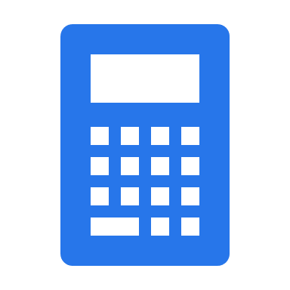
You can use Python as a calculator
+/-
/
Additions and subtractions
Divisions
print(10/2)
print(“apple”/2)
print(5+5)
print(5-5)
print(“5+5”)
Errors
*
Multiplications
Just like you could make a grammar mistake in your homework, it is very easy to make a mistake while writing code.
Errors in code are what produce bugs in the program. With practice, we’ll learn together how to debug a code.
print(5*2)
print(“apple”*3)
print(“apple*3”)

Slide 11
You can use Python as a calculator (2)
%
(x)
Modulo
Rounding
Round(4.5)
x = 10
y = 3
Print (x % y)
True and False
//
Floor division
x = 10
y = 3
Print (x // y)
Boolean values in Python.
We use comparison operators for these expressions:
x == y
x != y
x > y
x < y
x >= y
x <= y

Slide 12
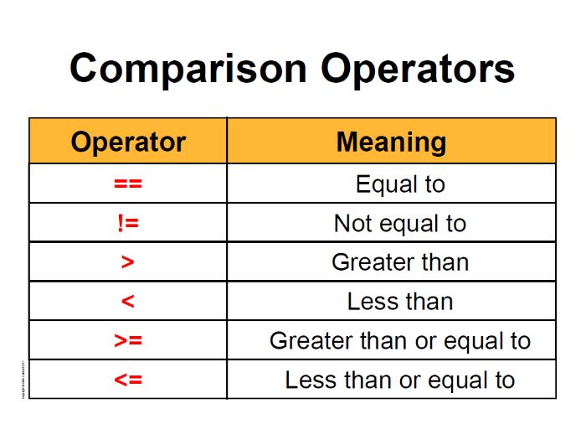
True or False
Examples
x = 5 == 6
print(x)
x = 5 < 6
print(x)
x = 5 <= 6
print(x)
x = 5 != 6
print(x)
x = 10
print( x < 15 and x > 5)
x = 10
print( x > 15 or x < 100)
x = 10
print(not x < 20)
Comparison operators
Used to check conditions and make comparisons

Slide 13
AND, OR and NOT Statements
Examples
And
AND evaluates to TRUE if all its operands are true and FALSE otherwise
What will this print?
x = 10
print(x < 15 and x > 5)
Or
OR evaluates to TRUE if at least one its operands are true and FALSE if NONE of it’s operands are true
Or this?
x = 10
print(x > 15 or x < 100)
Not
NOT evaluates to TRUE if the operand is FALSE, and returns FALSE if the operand is TRUE
Or this?
x = 10
print(not x < 20)
Statements
Instructions that Python can interpret and execute!

Slide 14
Strings, Floats, Integers, and Booleans!
01
Strings
A string is a sequence of characters that is read as ONE element. It can be letters, numbers, symbols, and emojis
Example
“Robot”, “123”, “☺”
02
Integers
An Integer(int) is a value used to represent whole numbers that DO NOT HAVE decimals("numbers after the comma").
Example
5, 123, 0

Slide 15
Strings, Floats, Integers, and Booleans!
03
Floats
A Float(float) is a value used to represent numbers that HAVE decimals("numbers after the comma").
Example
2.0, 3.6666, 555.5555555
04
Booleans
Boolean statements are statements that evaluate to be true or false.
Example
Boolean = True, Boolean = False

Slide 16
Introduction to Input
Write your first interactive code!
Exercise 1
Exercise 2
Welcome to the world of Coding!
Let’s multiply two numbers!
Ask the user for their name using INPUT
Assign it to a variable
Concatenate the name variable with a welcoming message in the print() function
Ask the user for two different numbers
Assign them to 2 DIFFERENT variables
Multiply both variables in the print() function
*Concatenate: link (things) together in a chain

Slide 17
Homework: Create an Interactive Calculator!
Homework Description
Create a calculator that can do additions, subtractions, and multiplications. Make sure to greet the user.
1
Greet the user using the print() and input functions.
2
Addition: Ask for two numbers using INPUT and calculate the sum in the PRINT() function
3
Subtraction: Ask for two more numbers and print the result of the subtraction
4
Multiplication: Ask for three more numbers and print the result of the multiplication

Slide 18
Homework Solution
1
# Greet the user
name = input("What is your name?: ")
print(name)
print("Welcome "+ name + " to my calculator!")
# Addition of 2 numbers entered by the user
print("ADDITION")
x = input("First number: ")
y = input("Second number: ")
addition = int(x)+int(y)
print(addition)
# Subtraction of 2 numbers entered by the user
print("SUBTRACTION")
x = input("First number: ")
y = input("Second number: ")
subtraction = int(x)-int(y)
print(subtraction)
2
# Multiplication of 3 numbers entered by the user
print("MULTIPLICATION")
x = input("First number: ")
y = input("Second number: ")
z = input("Third number: ")
multiplication = int(x)*int(y)
print(multiplication)
# Thank you message
print("Thank you for using my Calculator!")

Slide 19
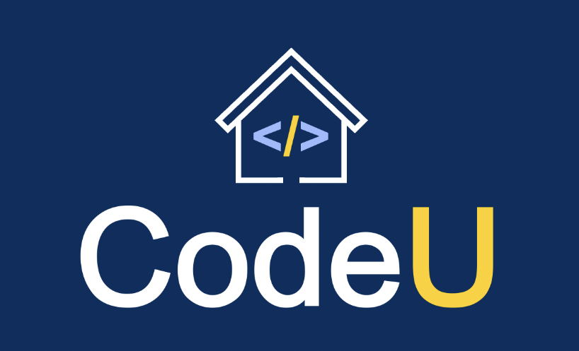


Thank you!
Does anyone have any questions?
Next class: class 2!
Phone:
(438) 391-9106
Please contact us to make any change in the schedule for the next class.
Email:
siva.sri14@hotmail.com
hello@codeu.ca
Website:
https://www.codeu.ca/
Reproduction and distribution of the presentation deck is prohibited

